Slide 1
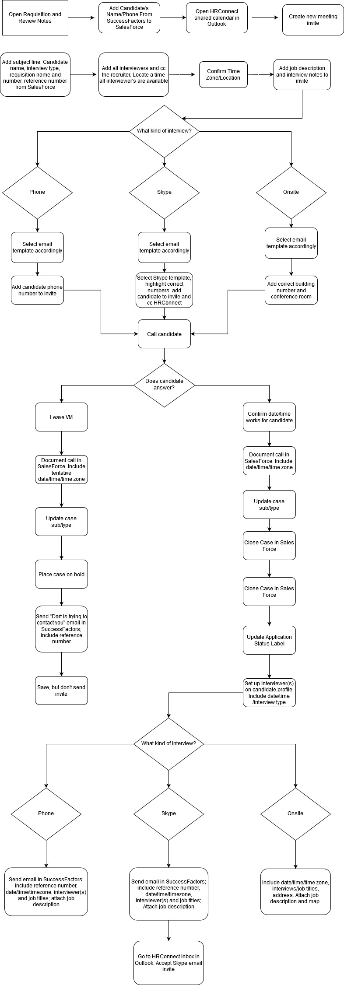

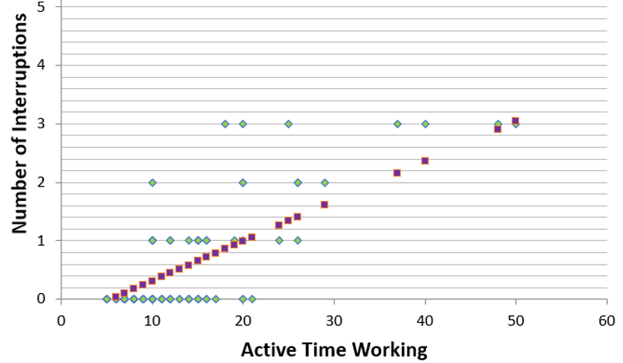
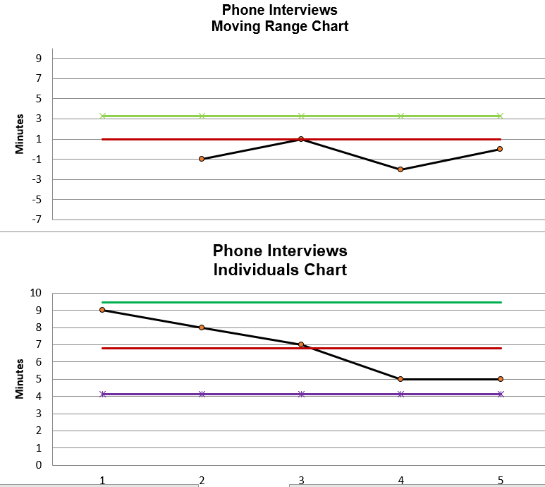


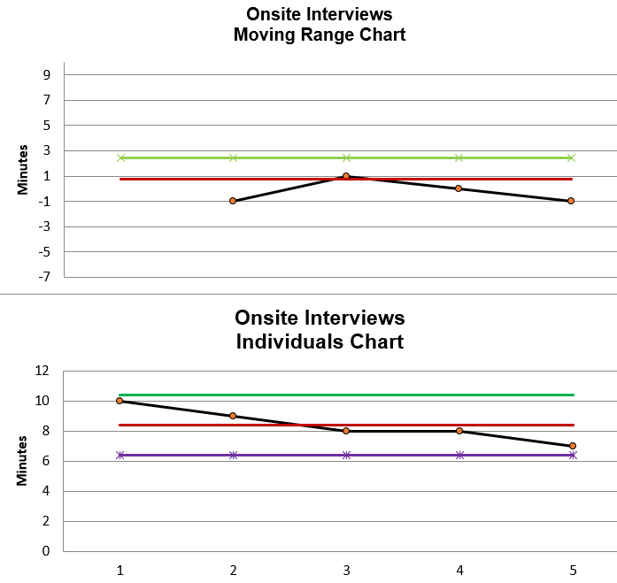
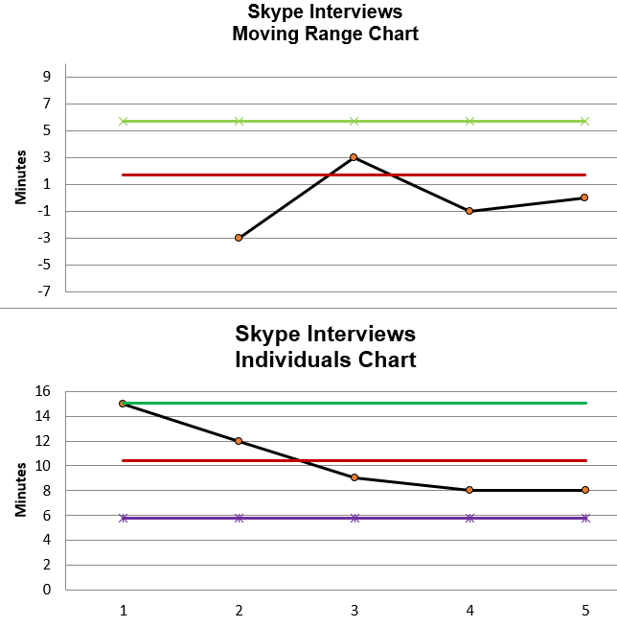
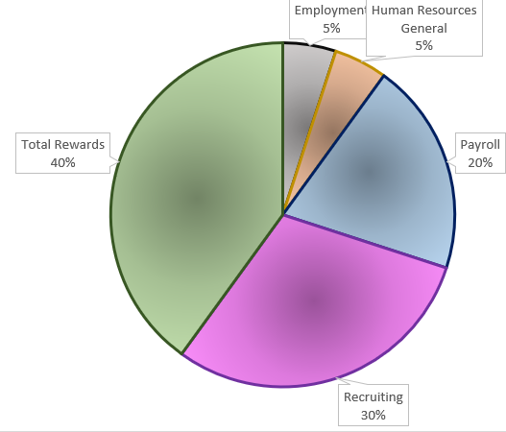
Process Improvement Project: Story Board
Project: How can we decrease the amount of time HR personnel spend scheduling candidate interviews?
Define
Measure
Analyze
Improve
Control
We look at different variables: number of interruptions
Grouping of schedules, recruiter, hiring manager, number of interviewers, and interview type.
Sigma Level 2.87
Moving Range Charts show that the process is stabilized
Sigma Quality Level Increases by .64!
Using a regression chart, we find a significant correlation between the length of time spent scheduling and the number of interruptions
Stats from the sample of interviews scheduled by interview mode
Order of scheduling (based on requisition) accounts for 3.41% of variation
The mean, median, standard deviation, and max of the range decreased for all three interview types. Overall, the average decreased by nearly 50%!
The presence/absence of interruptions accounts for 71.68% of variation
With recruiting cases making 30% of HR’s cases, cutting down the amount of time spent, especially as hiring increases, is important.
Measuring by Recruiter – fail to reject null hypothesis
Due to business need, flexibility is still required; associates will rotate being the designated scheduler for the day or half-day depending on business need.
Sigma Level 2.23

Slide 2
Define
The problem, restrictions, variables, and output

Slide 3
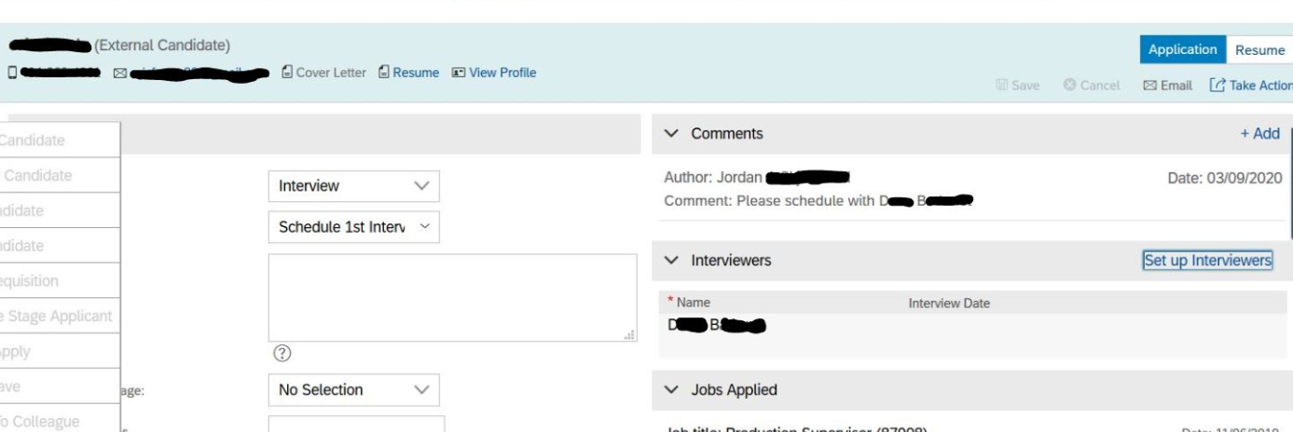
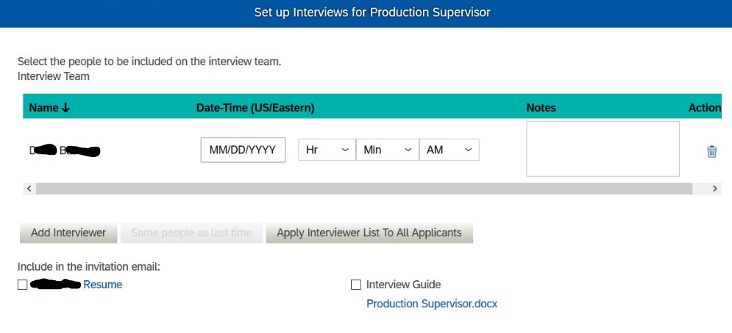
…Yes, all of that to schedule one interview!
A team of four in Mason, MI schedule interviews for over 20 locations across the country, for dozens of hiring managers and positions that range from manufacturing, clerical, fitness coach, etc. Each job posting (“Requisition”) will have different scheduling requirements for each interview level (first, second…) based on the hiring manager(s) schedule, position need, etc. Multiple software programs are used: SalesForce, SuccessFactors, and Microsoft Outlook. A request to schedule a candidate comes in through a SalesForce case, and each case is a request for a single candidate. Scheduling interviews is not the primary function of our job, yet we spend 20%-85% of our day scheduling.
Goal: Decrease amount of time spent scheduling an interview by 30%
Restrictions: Some of these steps include redundant documentation. For example, we can view when an interview is scheduled through the following means: 1. Documented in SalesForce in the call documentation field; 2. in the SalesForce Checklist; 3. in the Outlook email; 4. In the interview section of Success Factors; 5. In the “letters sent” section of Success Factors. However, these redundancies are due to compliance reasons and due to differing access to software. (HRConnect can see SalesForce, Success Factors, and Outlook, Recruiters can see Success Factors and Outlook, and Managers can see Outlook and parts of SuccessFactors.)
Setting up the interview in Success Factors
While this may seem like the most superfluous step of the process, since anyone looking at the application can also see that by looking at the correspondence section if/when an interview has been set up, this documentation serves a compliance purpose in our Applicant Tracking System for reporting purposes.
Why have the checklist in SalesForce? The checklist in SalesForce serves a purpose beyond additional documentation; this also triggers a follow up email to be sent to the candidate advising them of the next steps of the process.
Can we interface SalesForce with SuccessFactors? One solution I looked into was interfacing Success Factors and SalesForce. Recruiters who don’t have access to view HRConnect cases could be granted limited access to only those cases categorized as “Recruiting” with a subtype of “Interview.” This would enable them to be able to see if/when interviews were set up. Confirmation emails could also be sent to the candidate through Sales Force, eliminating all repeated documentation in SucessFactors. The interfacing software, however, would take time to be approved, would have additional costs, and would take further time to be set up and fully implemented. This is a possibility for the future, but not an immediate solution.

Slide 4
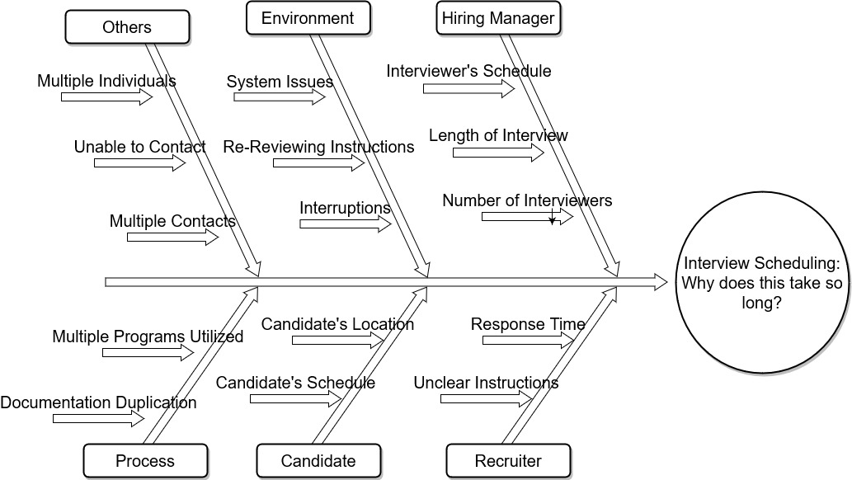
When going back and forth between scheduling candidates for different requisitions, it’s easy to mentally carry over a trait of one to another (ex. I schedule 2 interviews for Federalsburg, MD, and then Corona, CA. I may forget to update the time zone, causing errors that will need correcting and possible confusion to the candidate.
Here are some of the factors/traits of scheduling interviews that can delay the process.
HR personnel are also expected to take “Service Center” calls. Interruptions made when an employee calls in to HRC causes us to have to pause a complex train of thought, have to back out of all the systems being used, and causes us to re-review details when we return to the scheduling.
Multiple individuals may have contact with the candidate; for example, if I make the initial call and leave a message with a candidate A, and they reach Lacey when they call back, Lacey has to first research all the notes I’ve already reviewed. For example, if the candidate cannot make the original time I had scheduled, Lacey needs to know that the manager requested interviews not be scheduled on Tuesdays and Thursdays. But she won’t know that unless she duplicates the efforts I had already made.
For IT positions, the manager likes to have all 12+ members of the team present for a 2 hour interview. Only none of them are ever in the same place for more than 20 minutes at a time!
Candidates who live out of state may not be as easy to schedule; they may have to first get time off of work, and once they do, we have to request travel accommodations.
For certain levels of positions, directors may want the candidate to be interviewed by 2-20 people during the interview, with each interviewer having 15-60 min. with the candidate. This requires having to type up schedules, send out a separate email invite to each manager, and coordinate all of those schedules
Some of factors we don’t have much control over. For example, if we have questions for a recruiter, they may not be available to answer right away. This causes us to have to pause and return to the process later.

Slide 5
Measure

Slide 6
How was the data gathered and measured?
Associates kept track of interviews they scheduled each day over the course of 3 weeks, recording the following information:
Requisition name and number,
Type of interview (phone, Skype, or onsite),
Recruiter name,
Interviewing manager name(s),
Number of interruptions,
Whether they were scheduling for multiple interviews in a row for the same requisition or not,
And any other circumstances that may have effected the scheduling process (for example, did they have to make multiple contacts to the candidate? Were there an excessive number of interviewers with difficult schedules to work around?)
Running time (continuous data) was calculated by noting the time they started the scheduling process until it was completed. The time clock was paused whenever an interruption such as an HRConnect phone call came in. Information was entered on to a shared spreadsheet each day, until there were at least 65 entries.
Ultimately, the variables of number of interviewers and hiring manager were not analyzed, as there was not a representative variation of these two categories among the interviews tracked (most hiring managers were not hiring at the time data was gathered, and only IT positions have more than 3 interviewers, and few of those positions were hiring at the time the data was gathered.)
The goal is to find a way to decrease the cumulative amount of time spent on scheduling an interview by 30%.

Slide 7
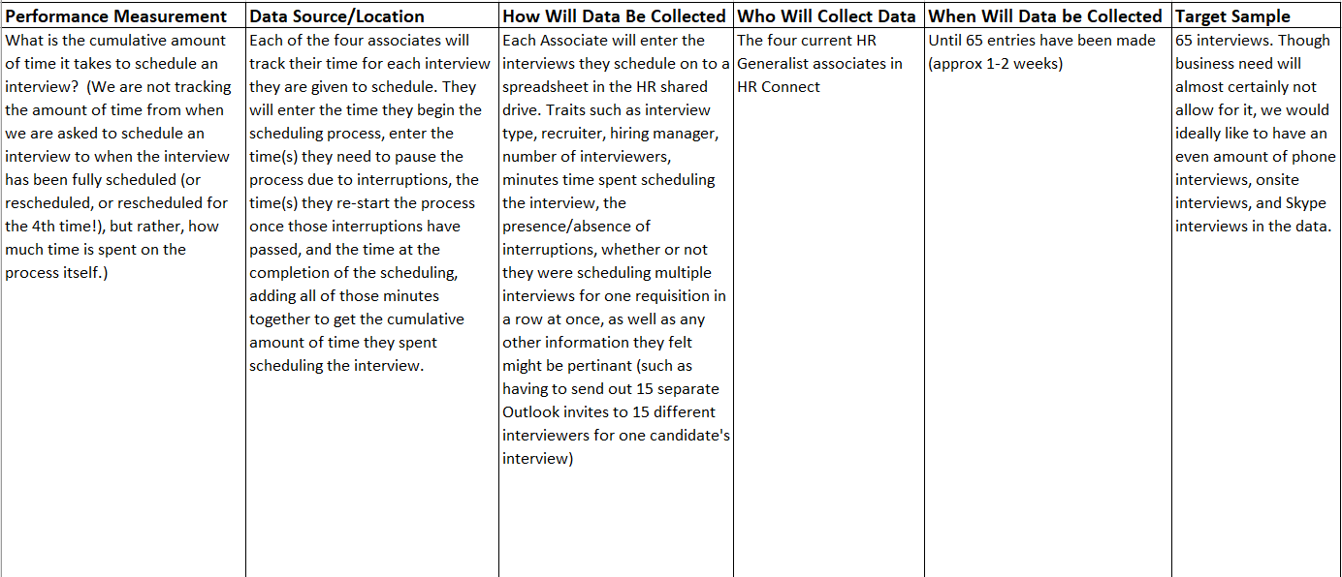
Data Measurement Plan

Slide 8
Sigma Quality Level
Mean: 16 minutes
Standard Deviation: 15 Min
LSL: 5 Minutes
USL: 120 Minutes
DPMO: 231,667.56
Sigma Level Short Term 2.23
Sigma Level Long Term .73
Measurement Error: The most likely cause of variation in measurements would be the lack of more precise measurement and reporter accuracy.
Measurements were taken in minutes, so the data could be skewed slightly, For example, scheduling started at 9:01:00 and was completed by 9:10:59 or 9:11:00, the measurements would differ by a full minute, even if there was only a 1 second difference.
And while associates scheduling interviews were as diligent as they could be when noting their begin/end times, including stop/re-start times due to interruptions, the nature of the interruptions might cause an associate to look at their time slightly later than would be ideal. However, this variation would not exceed much more than 1 minute, as associates did not record those interviews where they were not able to note their times within a few moments of their actual start/pause/end times.

Slide 9
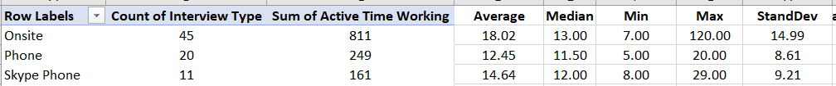
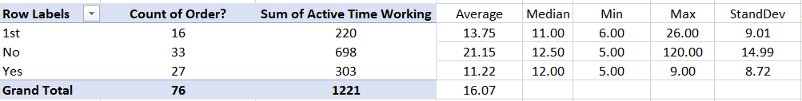
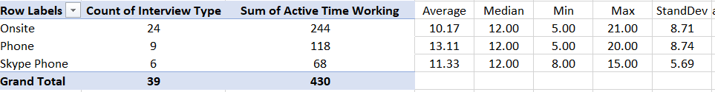

All items in sample
By presence of interruptions
Grouping scheduling
In order, no interruptions

Slide 10
How Many Interviews Need to be in the Sample Size?
Estimated Population Mean with a 95% confidence interval:
Lower = 16- 1.96(15/8.72) = 24.15
Upper = 16+1.96(15/8.72) = 30.89
Margin of Error with a 95% confidence interval: =15/8.72 = 1.72
=1.96*1.72 = 3.37
Sample Size:
=((1.96*15)/3.71)Sq = 62.89 (63)
The sample size would need to be at least 63 interviews

Slide 11
Analyze

Slide 12
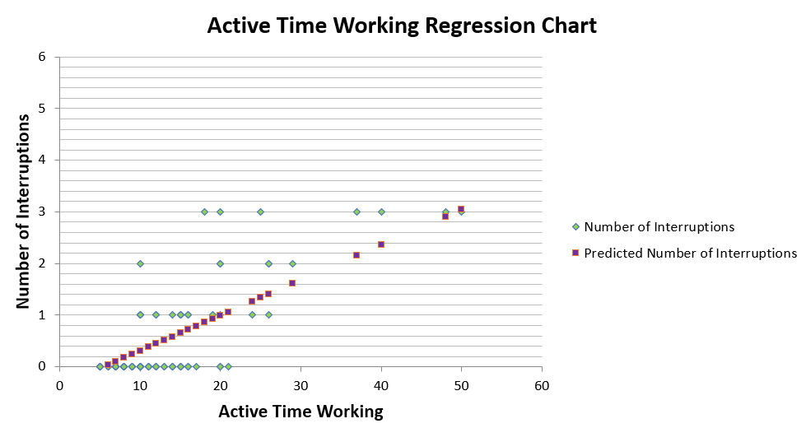
The biggest aggrieving factor of scheduling interviews is trying to do so while the phone starts to ring, diverting the scheduler’s attention to telling someone for the 102nd time that day that all applications have to be submitted online, and that insurance changes can’t be made outside of open enrollment without a qualifying life event. It’s clearly a bit of a sore point, but does it have a negative impact on how long it takes to schedule an interview?
The outlying 120 minute call with 7 interruptions was not included on the graph or in the next regression graph for visual reasons, but it was consistent with the trend shown and in the next graph.
R Square = 0.716866
P-Value = 0.001048
The presence/absence of interruptions accounts for 71.69% of variation
Based on the figures in this regression chart, there is a positive correlation between the number of interruptions and the cumulative time spent scheduling an interview.

Slide 13
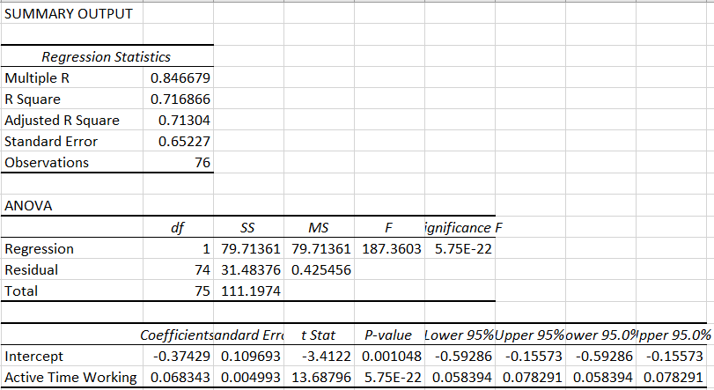

Slide 14
Out of coincidence, I was handed three interviews to schedule that were all for the same requisition. I commented to by co-workers how much more smoothly scheduling went, since I didn’t have to re-review requirements and restrictions, locations, time zones, etc. When time permitted, we would intentionally swap so that we each of us had all of the interviews that needed to be scheduled that say for a single requisition, and the opinion was unanimous. Consequently, this was chosen as a variable to study.
R Square = 0.034102
P-Value = 1.98E-08
For example, “0” means an interviewer scheduled only one interview from a requisition; “1” means it was the first interview from a requisition scheduled by an associate after which they immediately scheduled other interviews for that requisition; “5” means it was the 5th interview in a row an associate scheduled for a given requisition. So rather than randomly being assigned interviews to schedule via a queue, an associate may manually select all of the requests for interviews for a given requisition at once to schedule.
Whether scheduling was done by grouping all interviews from one requisition together or not accounts for 3.% of variation

Slide 15
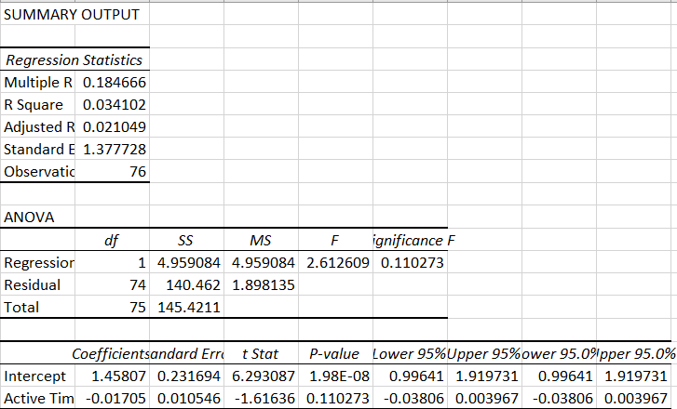

Slide 16
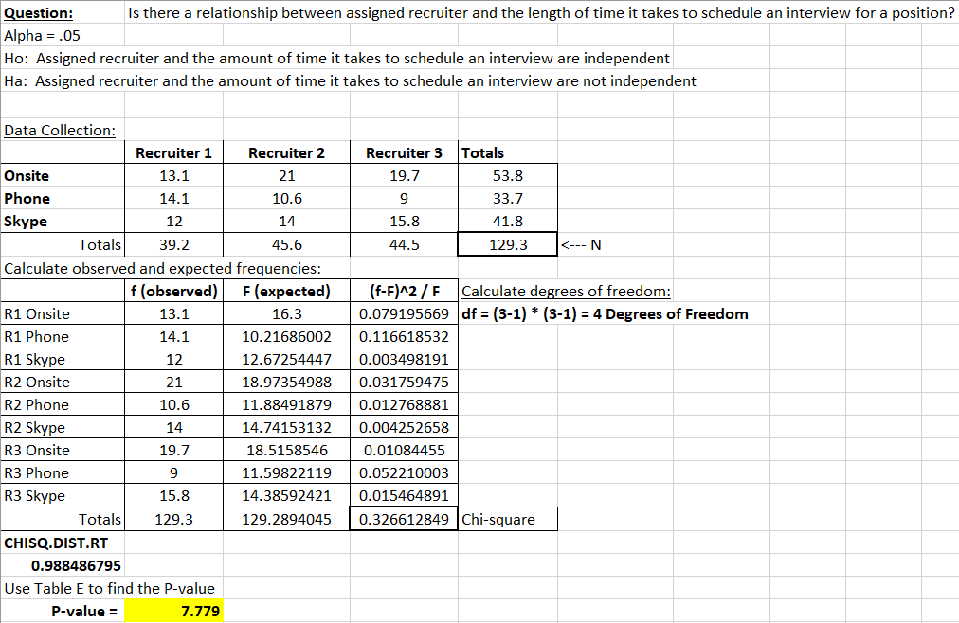
It has been suggested that working with certain recruiters is easier than others. Are there recruiters whose requisitions take longer to schedule?
While the number of interviews sampled is evenly distributed among the recruiters, the number of each type of interview is not even among all recruiters.
Since the P-value is high, the null hypothesis stands: there does not appear to be a relationship between the recruiter and the length of time it takes to schedule and interview.

Slide 17
Improve

Slide 18
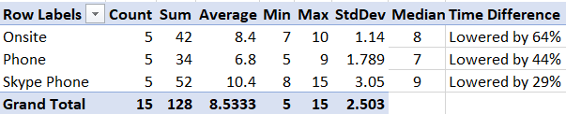
A trial was run for one day where one individual was assigned to exclusively schedule interviews, and was exempt from having to attend to any interruptions. The goal was also to manually organize the interview requests to group those for a given requisition together.
All interview requests were completed before mid-day, and the associate could then concentrate on other tasks.
Sigma Quality Level
Mean: 8.5 minutes
Standard Deviation: 2.5 Min
LSL: 5 Minutes
USL: 15 Minutes
DPMO: 85,417.85
Sigma Level Short Term 2.87
Sigma Level Long Term 1.37
The average, standard deviation, median, and the max of the range decreased for all three interview types.
Goal Met! Although the goal to lower time by 30% fell short by 1% when it came to Skype phone interviews, phone and onsite interviews exceeded the goal.

Slide 19
Control

Slide 20
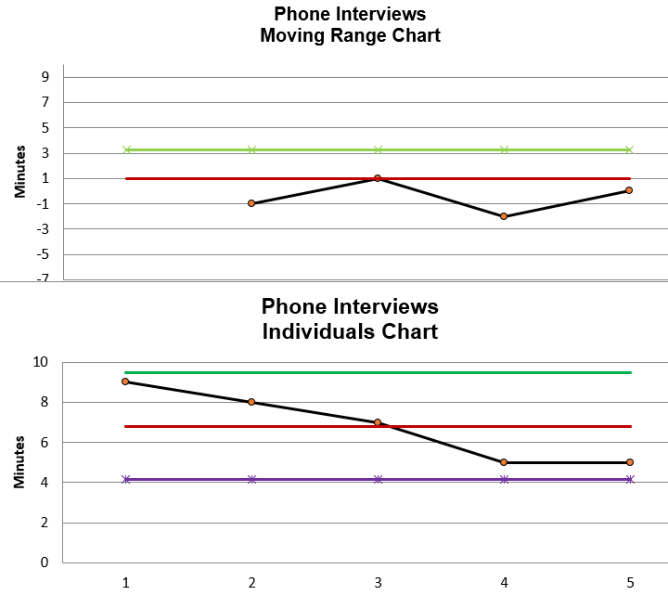
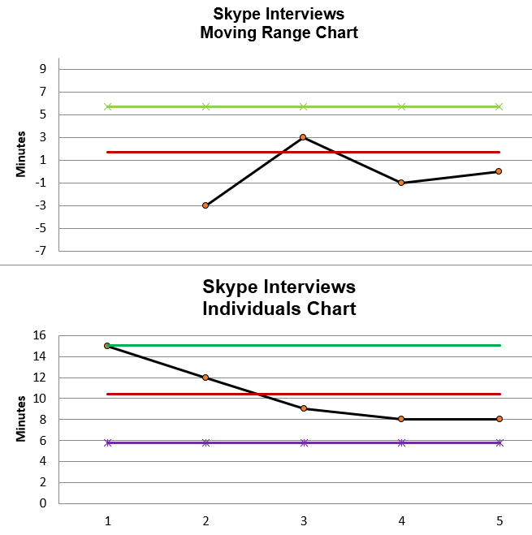
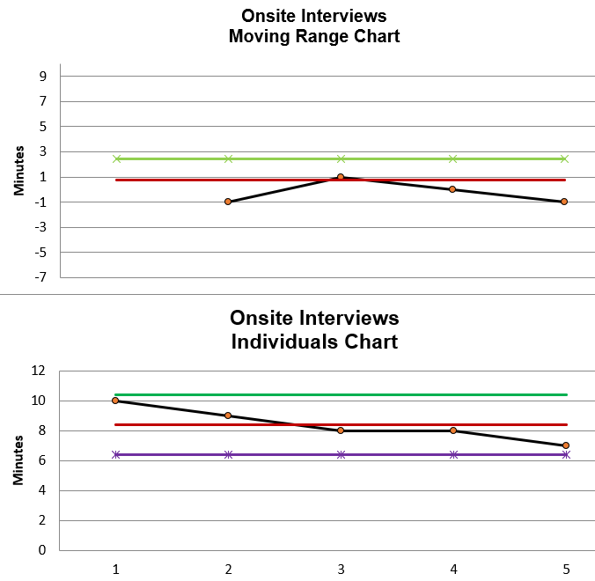
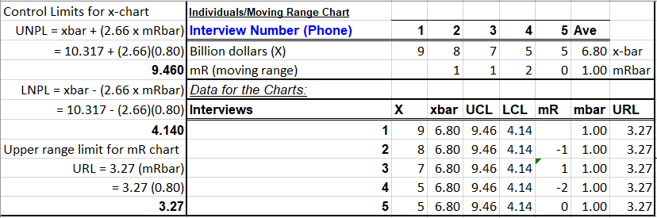
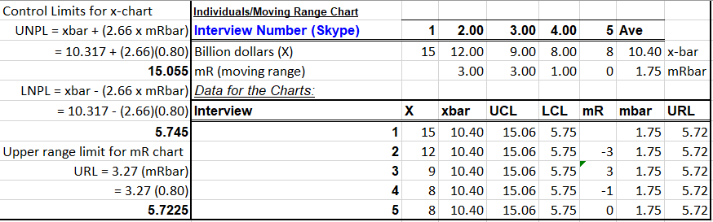
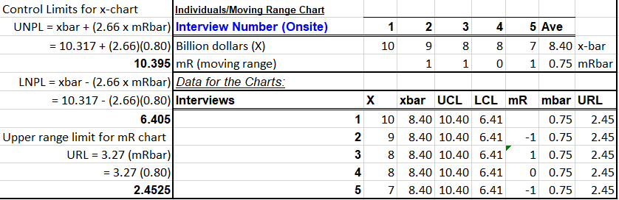
With new procedures in place, we see that not only has the time it takes to schedule an interview decreased, but the process has stabilized based on 5 random post-improve phase interviews for each interview type.

